Slide 1

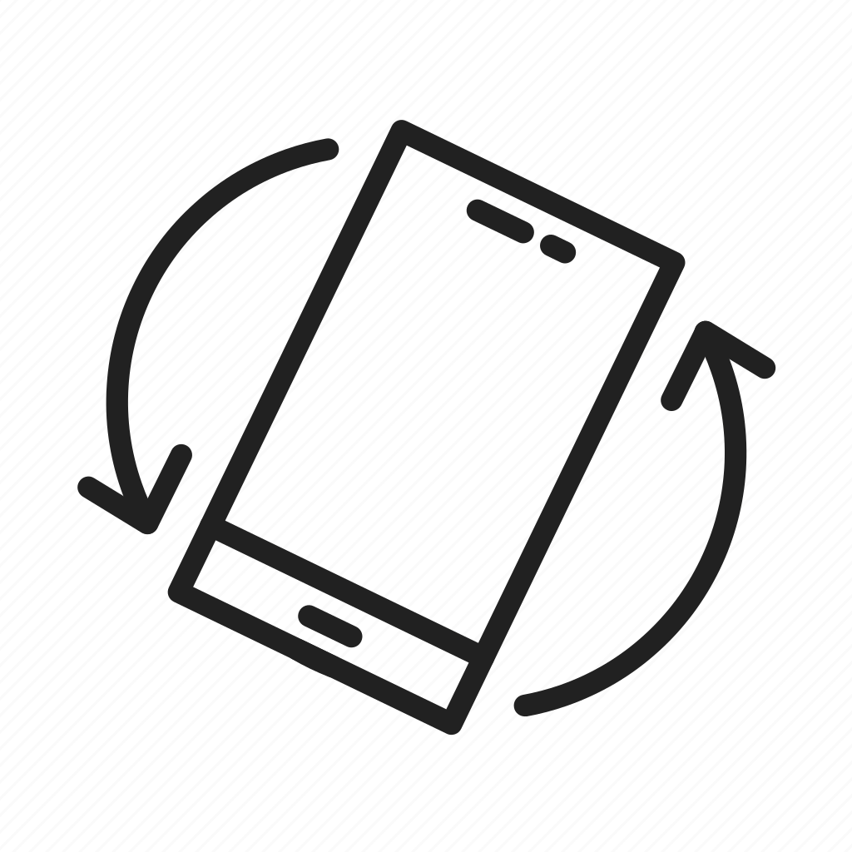
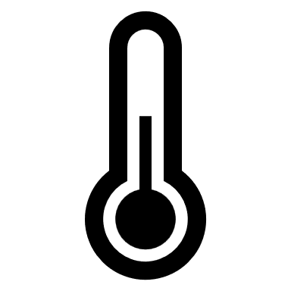

IoT for Lunch Technology for your LunchBox
N11388633 Tristan Calilung
ifN649 Advanced networks
Notes:
Good Morning Everyone
Today I’m presenting my I o T proposal for IFN 649
The name of my project is IoT for Lunch.

Slide 2
Concept
What is it?
An IoT device that can be used to measure the temperature and orientation of your lunchbox.
Why?
Lifestyle choices, people may opt to eat foods with no preservatives.
Confidence knowing the temperature of your food in areas with no refrigeration.
Notifies you of rapid temperature changes of your food i.e., Environmental Changes, Tampering.
How?
Uses MQTT, so with a phone app you can monitor and set modes.
4 Modes:
Mode 0 – Off
Mode 1 – Temperature and Tilt (Default)
Mode 2 – Temperature Only
Mode 3 – Tilt Only
Separate Devices
Device 1 - Temperature and Tilt Sensor
Device 2 – Remote to choose modes
Device 3 – Audio and Visual Display

Slide 3
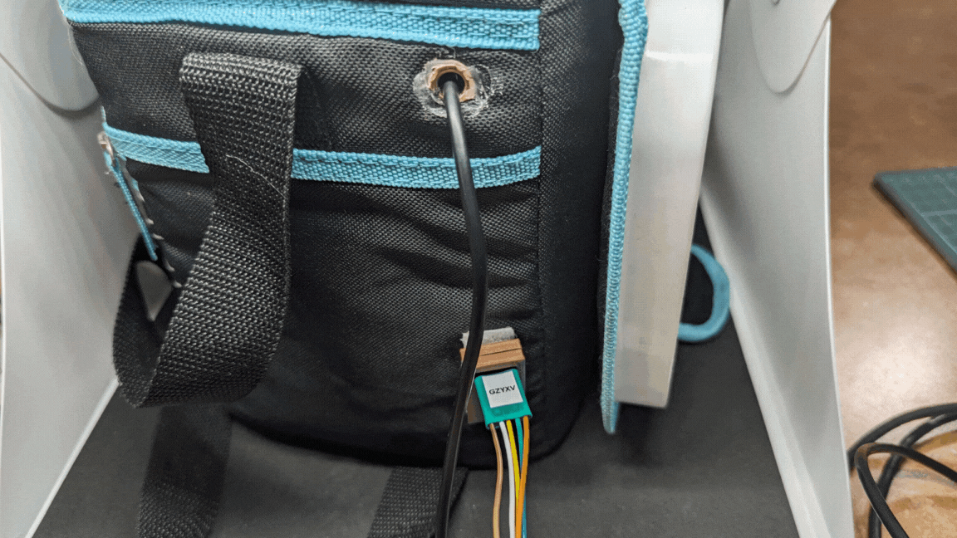
Device 1
Data is received and sent through Bluetooth to a Tier 2 Device (eg Raspberry Pi4)
Reads Temperature within the lunch box.
Temperature Range for Food:
Less than 4°C (Safe)
4°C to 8°C (Caution)
More than 8°C (Warning)
Tilt sensor on side of lunch box to measure tilt.
Tilt Range
Y Axis = More than 600 (Stable)
Y Axis = Less 600 and more than 570 (Tilted)
Y Axis = Less than 570 (Tipped)

Slide 4
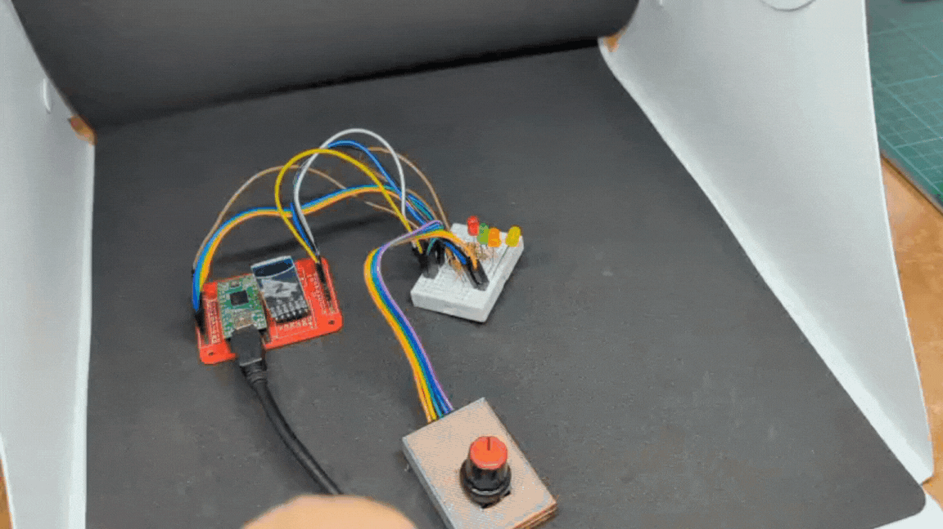
Device 2
Sends through Bluetooth to the Tier 2 Device.
Controlled by a Rotary Encoder with a button.
Led Selection
Red Off
Green Temperature and Tilt
Orange Temperature Only
Yellow Tilt Only

Slide 5
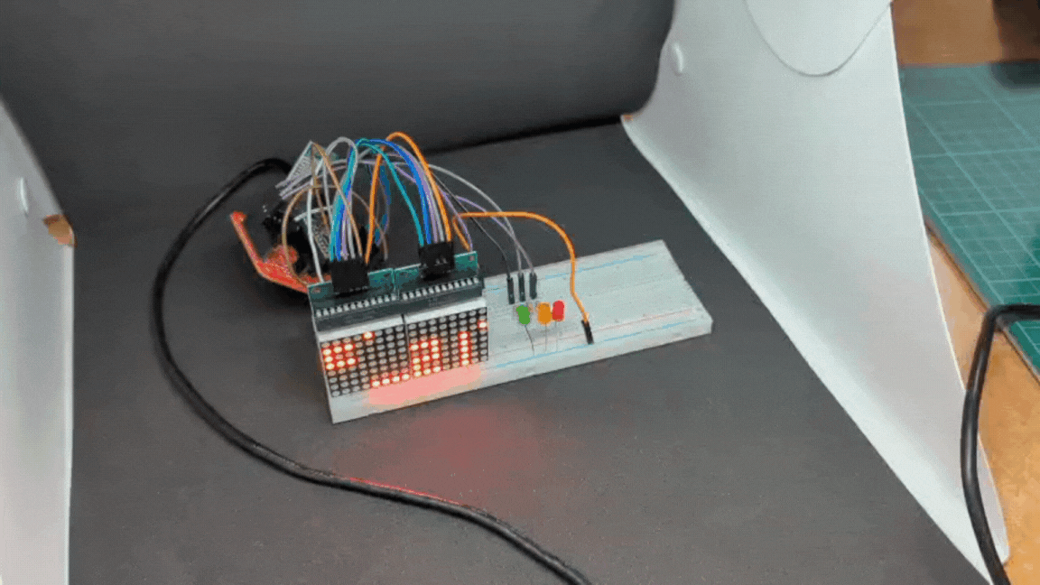
Device 3
Receives data through Bluetooth from tier 2 Device.
Displays Temperature.
LED Indicators for warnings.
Green is Safe
Yellow is Caution
Red is Warning
Buzzer Tone for warnings.

Slide 6
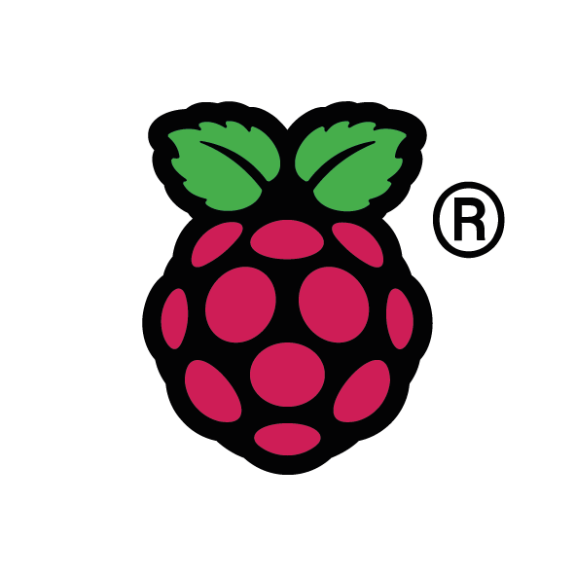

How?
Publisher
TIER 1 | TIER 2 | TIER 3
ifn649
Device 1
Ifn649_mode
Subscriber
Device 2
ifn649
Ifn649_mode
Device 3

Slide 7
Use Cases
Device 1
Multiple applications for temperature monitoring or tilt monitoring
Outdoors
Device 2
A simple controller for the device.
Device 3
Can be mounted on a wall as a visual guide.
Placed on a table next to your workspace as a temperature monitor.

